Slide 1
Fourth week report (Dataset Fairness Cont.)
Yueyang Qin
Koganti Sri Harsha

Slide 2
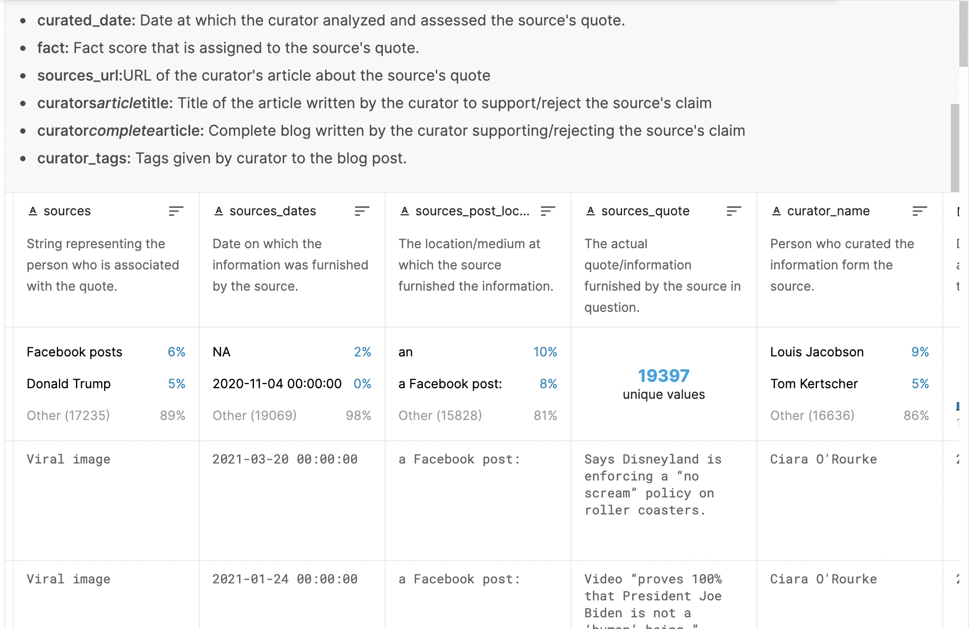
Dataset for experiment
https://www.kaggle.com/shivkumarganesh/politifact-factcheck-data

Slide 3
Github opensource that we can go through for fairness
https://towardsdatascience.com/evaluating-machine-learning-models-fairness-and-bias-4ec82512f7c3
One example inside this link is the github repo: https://github.com/adebayoj/fairml

Slide 4
Experiment Dataset result
Go to notebook demo.
Which also find the shortness for the dataset.
Might only can use the NLP
Some other method, need to research for how to apply the Logistic regression for fake news detection

Slide 5
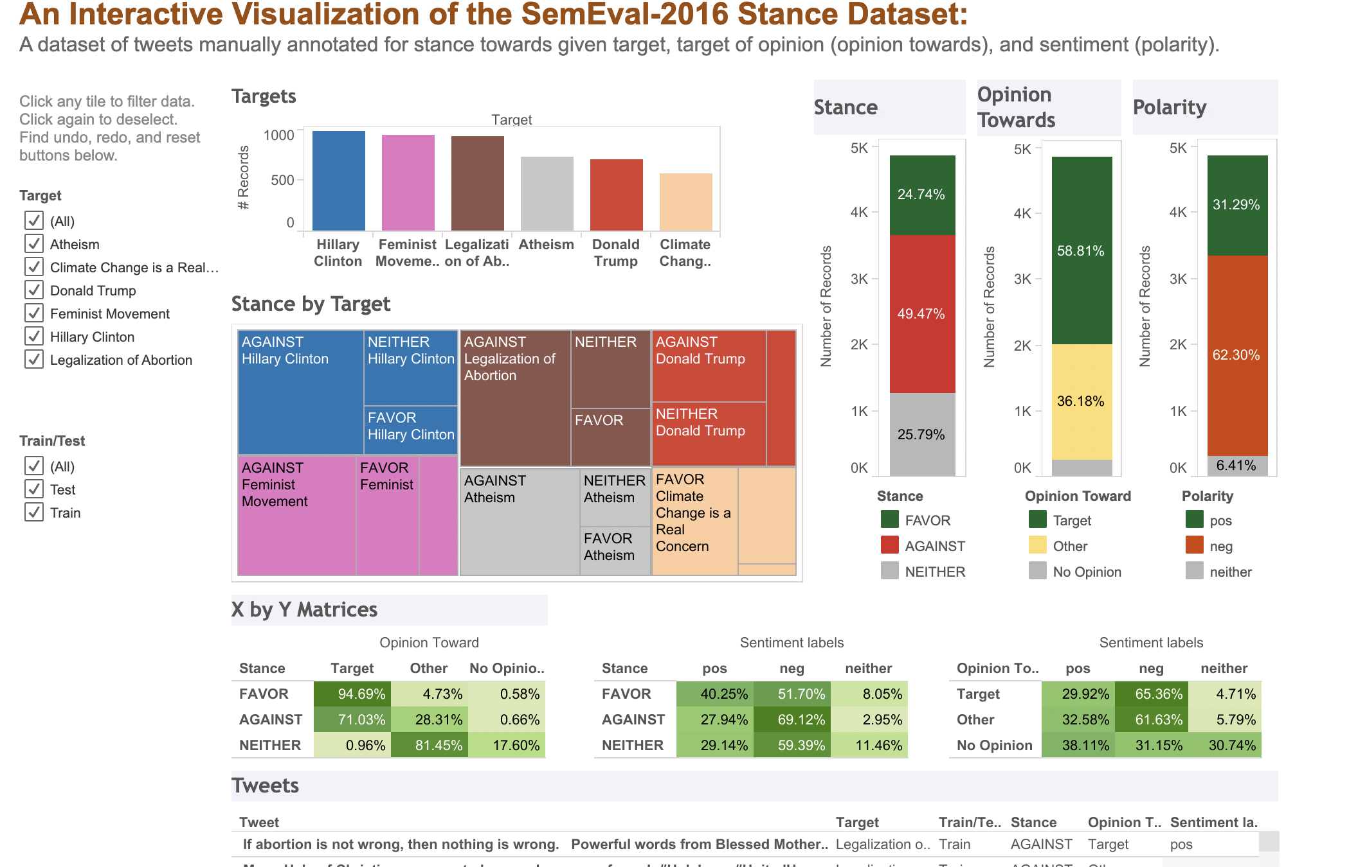
Thanks Z
https://www.saifmohammad.com/WebPages/StanceDataset.htm

Slide 6
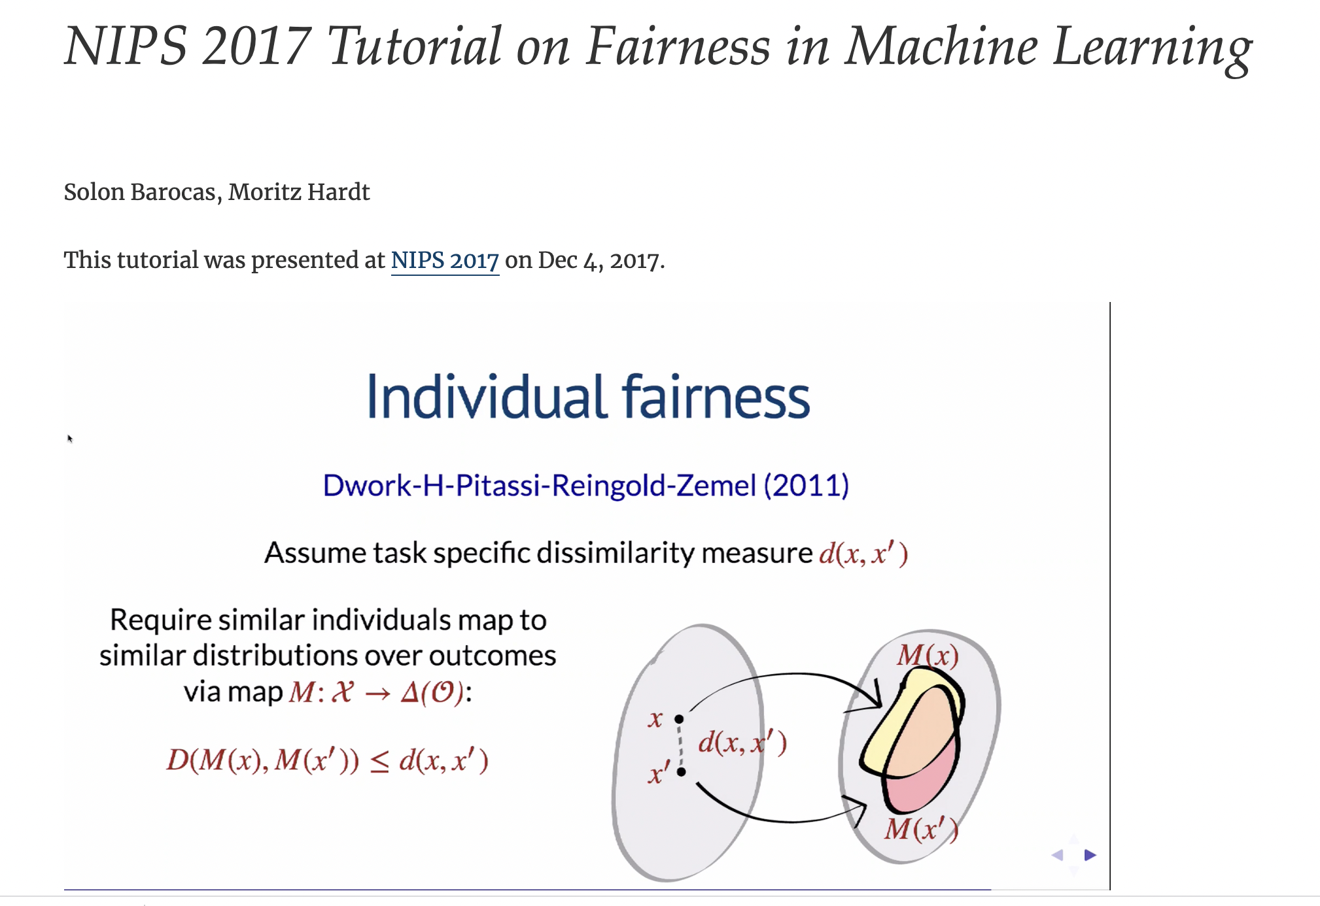
Some video tutorial link for understand the fairness
https://fairmlbook.org/tutorial1.html

Slide 7
Some other links need to cont. work
https://www.youtube.com/watch?v=MzuoWAk9_AQ
https://sites.google.com/view/fairness-tutorial
https://www.youtube.com/watch?v=hTHDY2Ir5x4
https://www.youtube.com/watch?v=euwc0va-7Vo
https://developers.google.com/machine-learning/crash-course/fairness/video-lecture
https://colab.research.google.com/github/google/eng-edu/blob/master/ml/cc/exercises/intro_to_ml_fairness.ipynb

